Slide 1


Slide 2

Java OOP and Data Structures with Introduction to Secure Coding Dr. Ziping Liu
Chapter 14 Generics

Slide 3
https://he.kendallhunt.com/product/java-oop-and-data-structures-introduction-secure-coding
Chapter 14 Generics

Slide 4

Chapter Outlines
What are generics?
Simple generic class
Generic interface
Simple generic method
Bounded generic type
Wildcards type
Inheritance relationship for generic class
Type erasure
Case study: revisit stack implementation—generic stack
Interfaces from java.util.function Package and Method References (available on the supplemental website)

Slide 5
14.1 What are Generics?
Java is a strongly-typed programming language - each variable must be declared with a specific data type
Object class is the superclass for all other classes, allows an Object instance to be cast to any subclass
Casting Object is not an ideal solution for designing general-purpose methods and classes
Generics act like a template, enabling type abstraction. With generics, we can define generic classes, interfaces, and methods. In a regular method, we replace parameters with concrete values upon invocation. Similarly, in a generic class, interface, or method, generic types—referred to as type parameters—are defined, and when these are used, we plug in concrete types to replace the generic type.

Slide 6
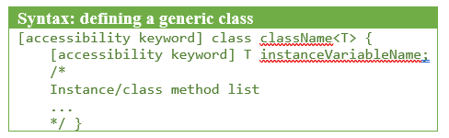
14.2 Simple Generic Class
A simple generic class can be defined
T: type parameter, representing a generic type
can be used to define the data type for instance/class variables, method parameters, or return types
A class with this structure is called a parameterized class
static field cannot be defined with type parameter
- top-level class cannot be declared as static
- the static keyword can only be applied to nested classes, and static nested class can also be generic
- static fields or static methods within a static nested generic class cannot directly use the generic type parameters of the enclosing class. This is because static members belong to the class itself, not to a specific instance with a particular type parameter

Slide 7

14.2 Simple Generic Class
Creating an instance of a generic class with a specific data type is called a generic type invocation, which replaces T with a concrete class type - type argument, such as String or Integer. In generics, T cannot be replaced with a primitive data type. The syntax to invoke a generic type is as follows:

Slide 8
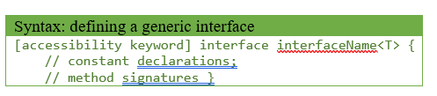
14.3 Generic Interface
a simple generic interface can be defined using the following format:
public interface Comparable<T> {
int compareTo(T o);
}
public class House implements Cloneable, Comparable<House> {
@FunctionalInterface
public interface Comparator<T> {
int compare(T o1, T o2);
boolean equals(Object obj);
// static methods
// default methods
}
class comparatorByArea implements Comparator<House>{

Slide 9
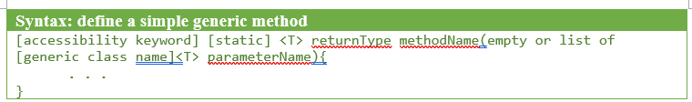
14.4 Simple Generic Method
A simple generic method can be defined using the following format:
when calling a generic method, there are two options:
one involves explicitly specifying the type argument before the method name
the other resembles a normal method invocation, without specifying a type argument - type inference, allowing the compiler to determine the appropriate type based on the context

Slide 10
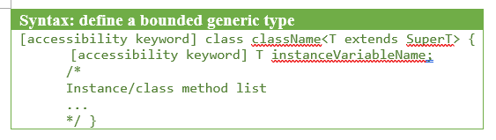
14.5 Bounded Generic Type
restrict a generic type to a specific category, such as a Number type or any of its subtypes, or an Animal type and its subtypes. In such cases, we can use the extends keyword along with the bounded type to specify an upper bound for the generic type. A generic bounded class can be defined using the following format:

Slide 11
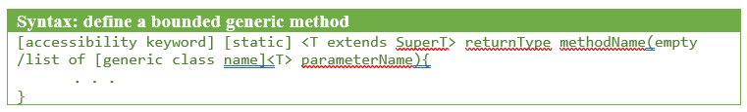
14.5 Bounded Generic Type
Similar as bounded generic class, a bounded generic method can be defined with the following format:

Slide 12


Slide 13


Slide 14
14.6 Wildcards Type
In Java, a question mark (?) used within a pair of diamond operators represents a wildcard type.
Unlike generic types, wildcard types can’t be used to define a class, interface, or method but are applicable for method parameters, local variable types, fields, and return types.
using wildcard types for return types is generally discouraged as it can introduce unsafe practices if the method's return type is ambiguous.
Wildcard types must be enclosed within diamond operators (<>), so they cannot serve as variable declarations; for instance, T var is valid, but ? var is not.
Generics support unbounded and upper-bounded types but lack lower bounds. Wildcard types, on the other hand, support unbounded, upper-bounded, and lower-bounded types.

Slide 15
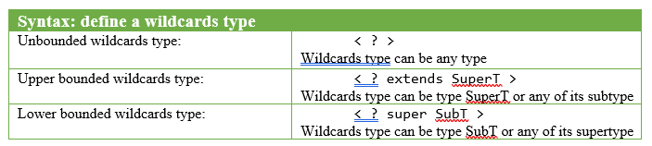
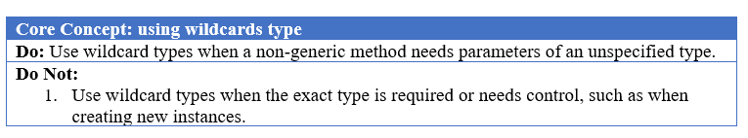
14.6 Wildcards Type
The syntax for using wildcard types is outlined below:

Slide 16
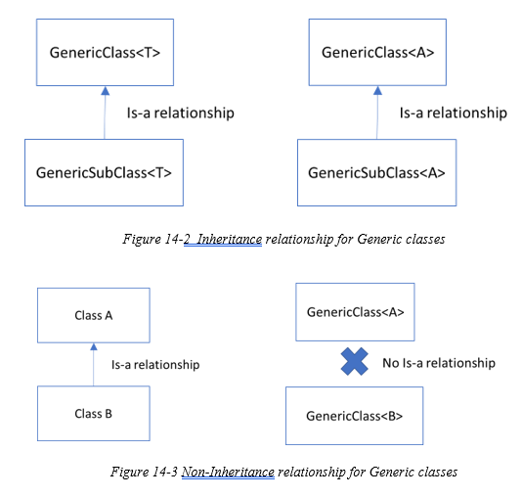
14.7 Inheritance Relationship for Generic Class
If a generic class GenericClass has a subclass GenericSubClass, an IS-A relationship is maintained between them when the same concrete type, say A, is provided as the type parameter for both classes
classes ClassA and ClassB have an inheritance relationship. However, when they are used as type arguments for GenericClass, the resulting concrete types GenericClass<A> and GenericClass<B> do not inherit from one another

Slide 17
14.8 Type Erasure
Java is a strongly typed programming language. To implement generics, the Java compiler uses a process called type erasure, which replaces the undefined type parameter with its bounded type or Object if the type parameter is unbounded
public class GenericType<T> {
private T t;
Replaced with:
public class GenericType {
private Object t;
public class measurementGeneric <T, U extends Number> {
private T type;
private U measurement;
Replaced with:
public class measurementGeneric {
private Object type;
private Number measurement;

Slide 18
14.8 Type Erasure
Java is a strongly typed programming language. To implement generics, the Java compiler uses a process called type erasure, which replaces the undefined type parameter with its bounded type or Object if the type parameter is unbounded
public static<T extends Comparable<T>> boolean isAscending(T[] anArray){
Replaced with:
public static boolean isAscending(Comparable[] anArray){

Slide 19
14.8 Type Erasure
With type erasure, it's important to remember that method overloading requires parameter types that are distinct after erasure. Different type arguments for generic parameters do not create distinct types
public static void addAnimals2(ArrayList<WildLife> list, Wildlife w){
list.add(w);
}
Will not work with the first defined:
public static void addAnimals2(ArrayList<Animal> list, Wildlife w){
list.add(w);
}
// after type erasure—both are erased to ArrayList

Slide 20
Which National Park is it?
Answer: Yellowstone National Park

